Slide 1
Discrete time Fourier Transform lecture 9

Slide 2
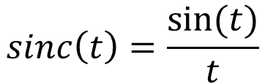
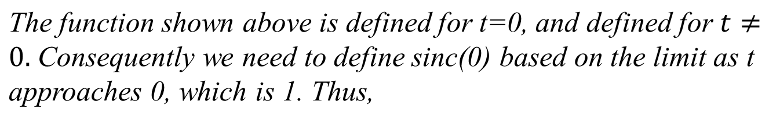
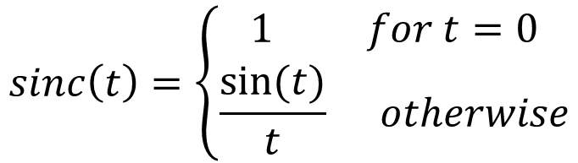
The Sinc Function
The mathematical formulation of the sinc function, also known as the cardinal sine function, is written as follows:

Slide 3
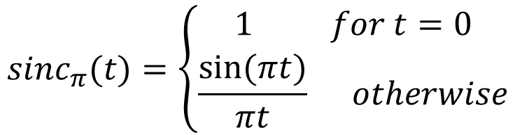
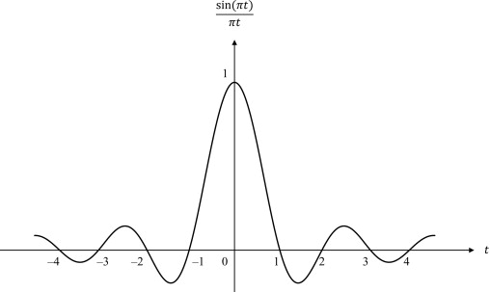
The Sinc Function
In the context of digital signal processing, we often use an alternative form in which the independent variable is multiplied by π:

Slide 4
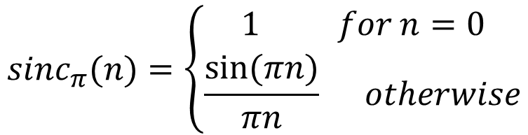
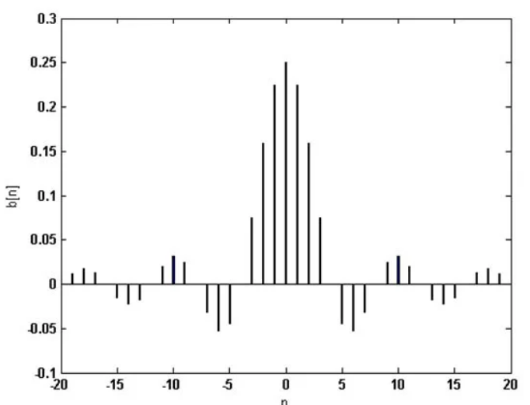
Discrete time sinc function
The discrete form of sinc function is,

Slide 5
Discrete-Time Nonperiodic signals: The Fourier Transform
The discrete time Fourier transform is a mathematical tool which is used to convert a discrete time sequence into the frequency domain. Therefore, the Fourier transform of a discrete time signal or sequence is called the discrete time Fourier transform (DTFT).

Slide 6


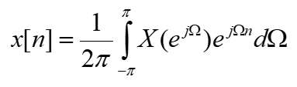

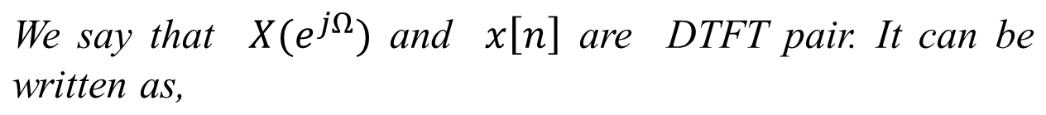
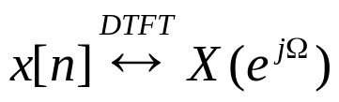
Discrete-Time Nonperiodic signals: The discrete time Fourier Transform
DTFT of a signal x[n] can be defined by,
Where,

Slide 7
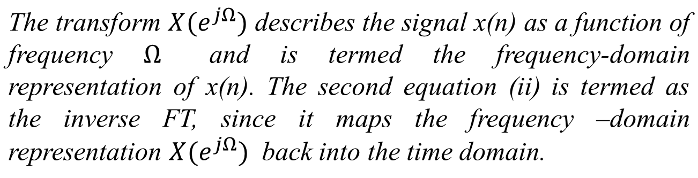
Discrete-Time Nonperiodic signals: The discrete time Fourier Transform

Slide 8
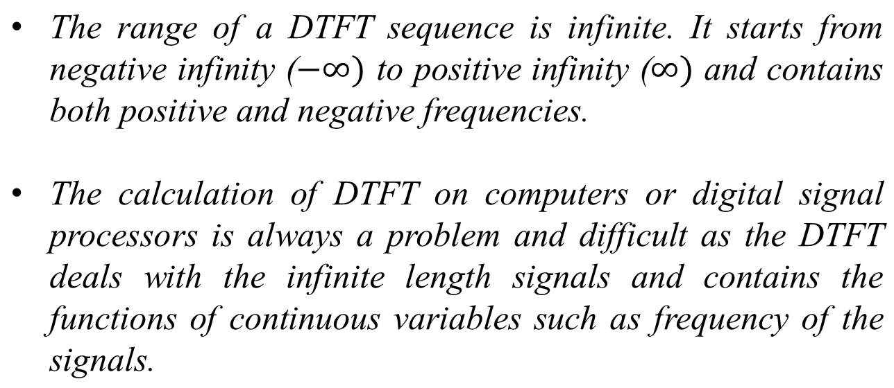
Discrete-Time Nonperiodic signals: The discrete time Fourier Transform

Slide 9
Discrete-Time Nonperiodic signals: The discrete time Fourier Transform
The DTFT is primarily used to analyze the action of discrete systems on discrete time signals.
DTFT uses discrete time, but converts to continuous frequency.

Slide 10
Relationship between Fourier series and Fourier transform
The Fourier series is used to represent a periodic function by a discrete sum of complex exponentials, while the Fourier transform is then used to represent a general, nonperiodic function by a continuous superposition or integral of complex exponentials.

Slide 11
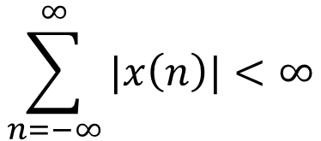
Conditions for Existence of Discrete-Time Fourier Transform
The Fourier transform of a discrete-time sequence x(n) exists if and only if the sequence x(n) is absolutely summable, i.e.,
The discrete-time Fourier transform (DTFT) of the exponentially growing sequences do not exist, because they are not absolutely summable.
This is a sufficient condition but not a necessary condition. That means if this condition does not satisfied then Fourier Transform may or may not exist.

Slide 12
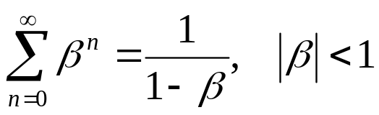
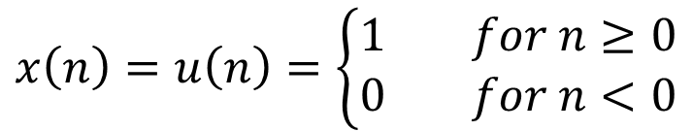
Conditions for Existence of Discrete-Time Fourier Transform
Find the discrete-time Fourier transform of the sequence x(n)=u(n) .
Given,
Solution
The given discrete-time sequence is,

Slide 13
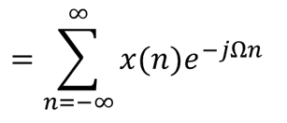


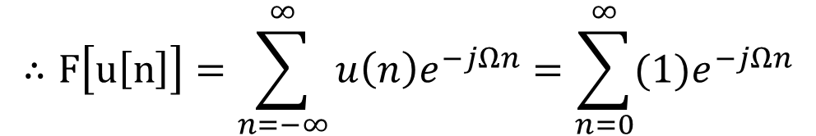
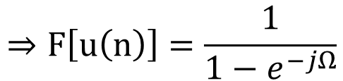
Discrete-Time Nonperiodic signals: The discrete time Fourier Transform
Solution
Now, from the definition of DTFT, we have,

Slide 14
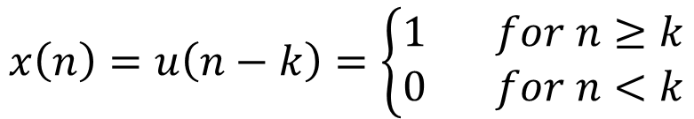
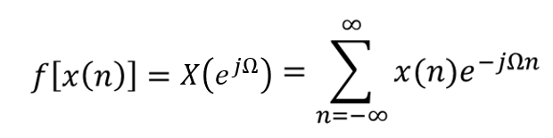
Discrete-Time Nonperiodic signals: The discrete time Fourier Transform
Find the DTFT of the sequence x(n)=u(n−k).
Solution
Now, from the definition of DTFT, we have,

Slide 15
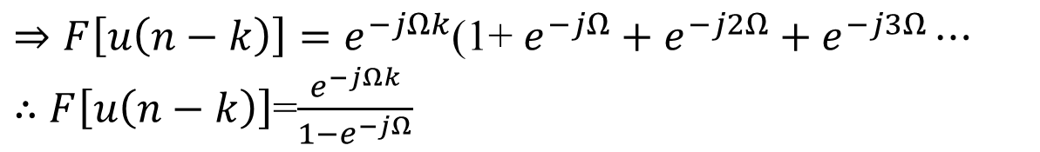
Discrete-Time Nonperiodic signals: The discrete time Fourier Transform
Solution

Slide 16
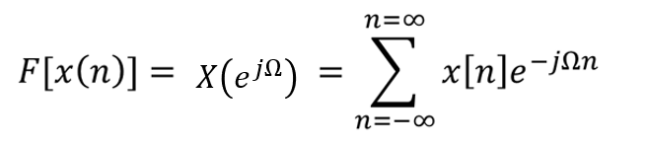
Discrete-Time Nonperiodic signals: The discrete time Fourier Transform
Find the discrete-time Fourier transform x(n)={1, 3, -2, 5, 2}
Solution
The given discrete-time sequence is,
x(n)={1, 3, -2, 5, 2}
The DTFT of a sequence is defined as −

Slide 17
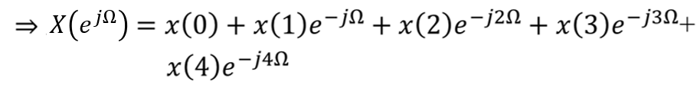
Discrete-Time Nonperiodic signals: The discrete time Fourier Transform
Solution

Slide 18
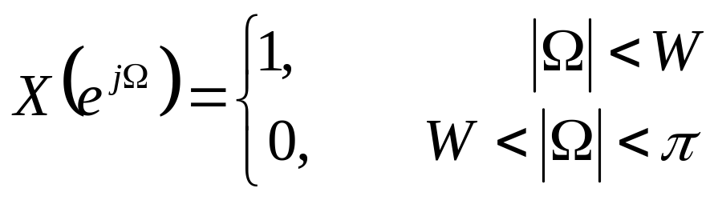
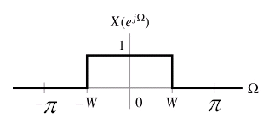
Discrete time Fourier Transform
Problem
Find the inverse DTFT of

Slide 19
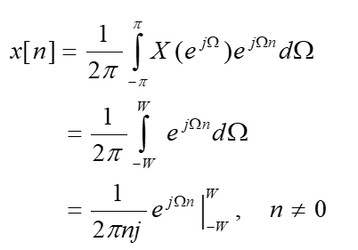
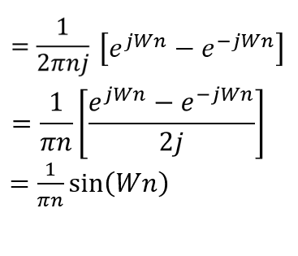
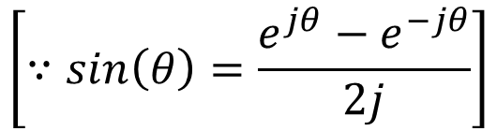
Discrete time Fourier Transform
Solution

Slide 20
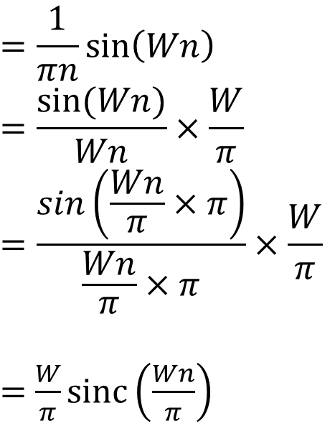
Discrete time Fourier Transform
Solution

Slide 21
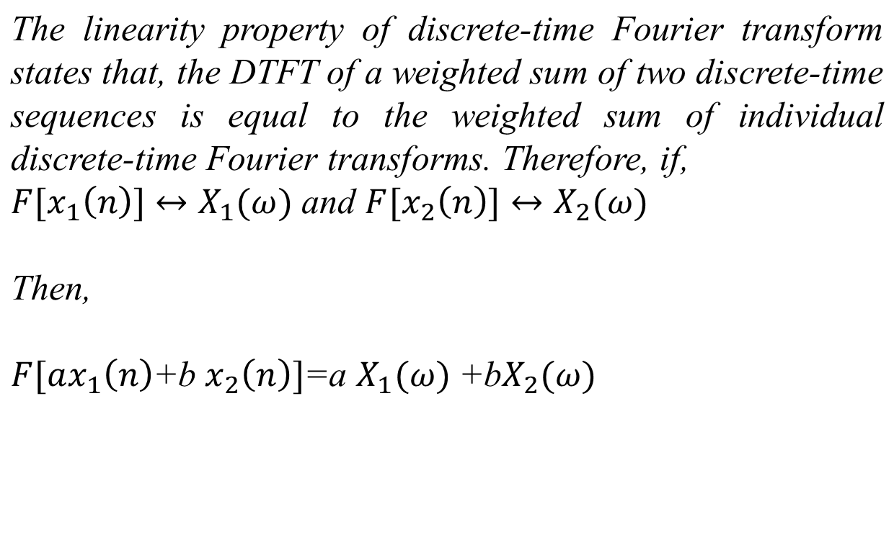
Linearity Property of Discrete time Fourier Transform

Slide 22
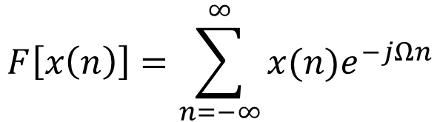
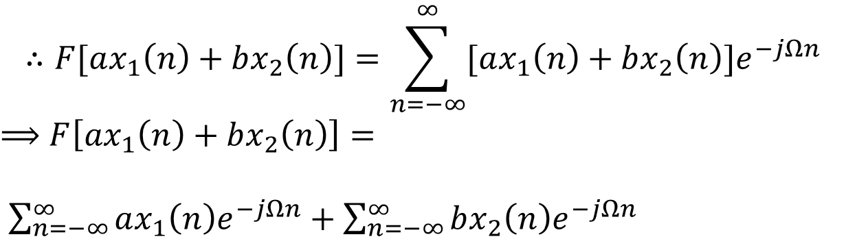
Linearity Property of Discrete time Fourier Transform
Proof
From the definition of discrete-time Fourier transform, we have,

Slide 23

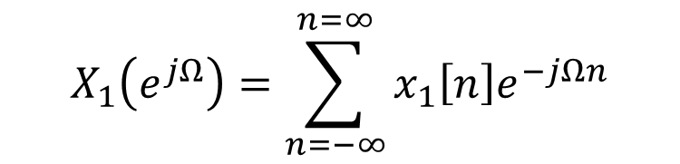
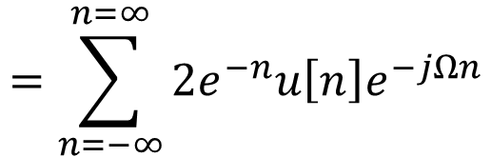
Linearity Property of Discrete time Fourier Transform
Problem
Using Linearity property determine the FT representations of the following signal:
Solution

Slide 24
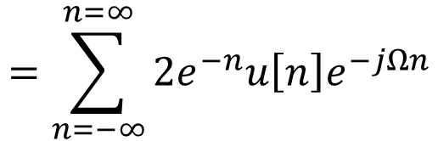
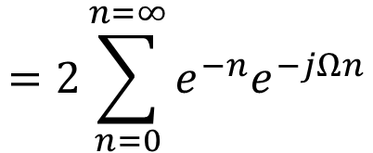
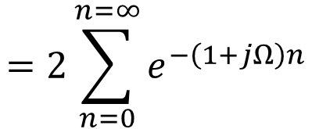
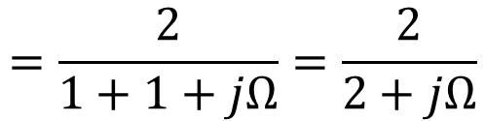
Linearity Property of Discrete time Fourier Transform
Solution

Slide 25

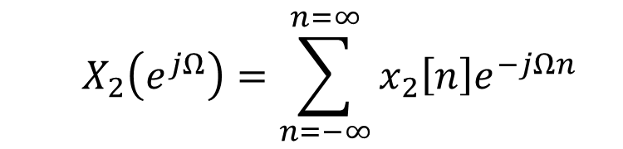
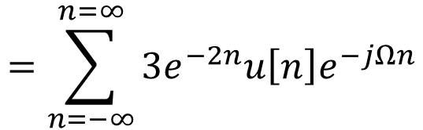
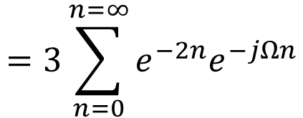
Linearity Property of Discrete time Fourier Transform
Solution

Slide 26
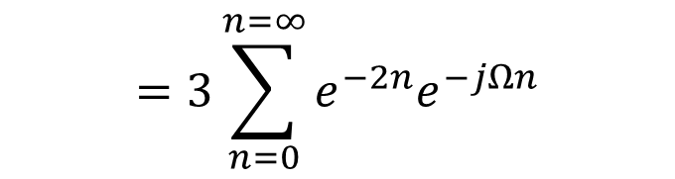
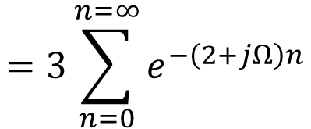
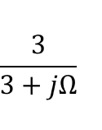

Linearity Property of Discrete time Fourier Transform
Solution

Slide 27
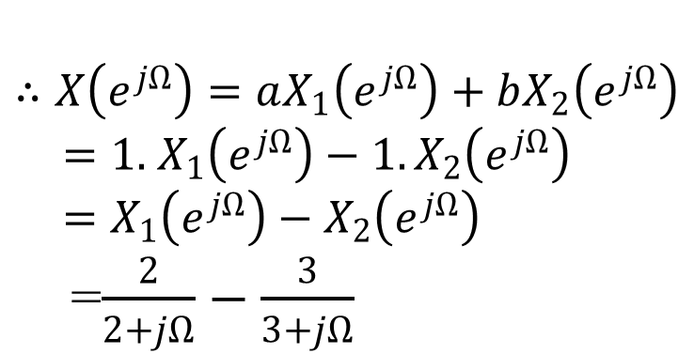
Linearity Property of Discrete time Fourier Transform
Solution

Slide 28


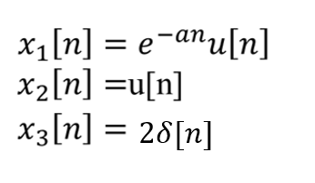
Linearity Property of Discrete time Fourier Transform
Problem
Solution

Slide 29
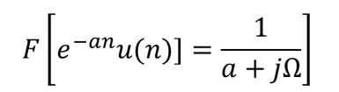


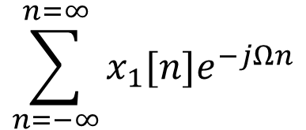
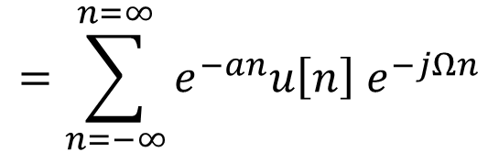
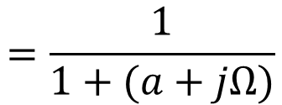
Linearity Property of Discrete time Fourier Transform
Solution

Slide 30





Linearity Property of Discrete time Fourier Transform
Solution

Slide 31



Linearity Property of Discrete time Fourier Transform
Solution

Slide 32

Convolution Property of Discrete time Fourier Transform
Solution
Then, according to time convolution property of Fourier transform,

Slide 33

Convolution Property of Discrete time Fourier Transform
Problem
Let x[n]=(1/πn))sin(πn) be the input to a system with impulse response h(n)= (1/πn))sin(2πn). Find the output y(n)=x(n)*h(n).
Given,

Slide 34


Convolution Property of Discrete time Fourier Transform
Solution
and

Slide 35








Convolution Property of Discrete time Fourier Transfon)rm
Solution
Since,
It follows that,
Hence,

Slide 36


Convolution Property of Discrete time Fourier Transform
Use the convolution property to find the FT of the system output, Y(jω) for the following input and impulse and system impulse responses:

Slide 37




Convolution Property of Discrete time Fourier Transform
Solution

Slide 38




Convolution Property of Discrete time Fourier Transform

Slide 39


Convolution Property of Discrete time Fourier Transform

Slide 40





Convolution Property of Discrete time Fourier Transform
Find,
Solution

Slide 41





Convolution Property of Discrete time Fourier Transform
Solution

Slide 42



Convolution Property of Discrete time Fourier Transform
Solution

Slide 43




Convolution Property of Discrete time Fourier Transform
Solution
Putting S=-3, we have A=3
Taking the inverse Fourier transform,

Slide 44


DTFT of the unit step function
Unit Step does not qualify the Conditions for Existence of Discrete-Time Fourier Transform
We cannot use the direct formula.
The DTFT of a unit step sequence defined as (No need to proof).

Slide 45



Time Shifting Property of Discrete-Time Fourier Transform
Then,
Where, k is an integer.

Slide 46


Time Shifting Property of Discrete-Time Fourier Transform
Solution
Since the DTFT of a unit step sequence defined as −

Slide 47





Time Shifting Property of Discrete-Time Fourier Transform
Solution
And

Slide 48


Frequency Shifting Property of Discrete-Time Fourier Transform
Then,

Slide 49


Frequency Shifting Property of Discrete-Time Fourier Transform
Solution
Since the DTFT of a unit step sequence is given by,

Slide 50



Frequency Shifting Property of Discrete-Time Fourier Transform
Solution

Slide 51


Time Scaling Property of Discrete-Time Fourier Transform

Slide 52




Time Scaling Property of Discrete-Time Fourier Transform

Slide 53

Differential in Frequency Domain Property of DTFT
The differentiation in frequency domain property of discrete-time Fourier transform states that the multiplication of a discrete-time sequence x(n) by n is equivalent to the differentiation of its discrete-time Fourier transform in frequency domain. Therefore, if,
Then

Slide 54



Differential in Frequency Domain Property of DTFT
Using frequency derivative property of Fourier transform, find the Fourier transform of function
Let,
Solution
By the definition of Fourier transform of a single sided exponential function, we have

Slide 55




Differential in Frequency Domain Property of DTFT
Solution
Now, by using the frequency derivative property of Fourier transform, we get,

Slide 56

Some Important Formula

Slide 57
End

